Slide 1
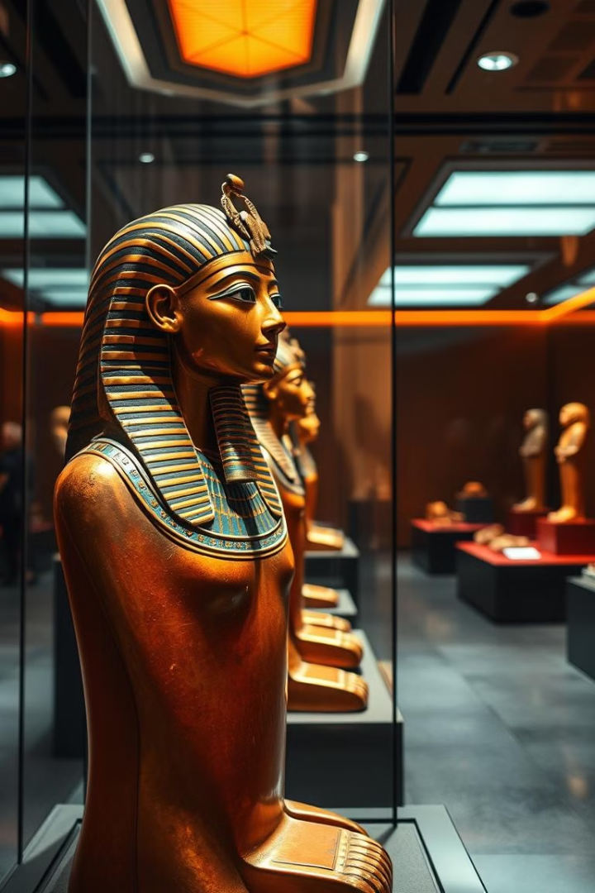
Antika Onlinstore: Marketing & Branding Plan
This presentation outlines a comprehensive marketing and branding plan for Antika Onlinstore, focusing on promoting unique Pharaonic-themed products to a global audience.

Slide 2
Understanding Our Audience
Demographics
Psychographics
Behavioral
Target age range: 18-55. Appeal to both luxury and budget buyers.
Target history lovers and sustainability-conscious consumers.
Target collectors, interior designers, and gift shoppers.

Slide 3
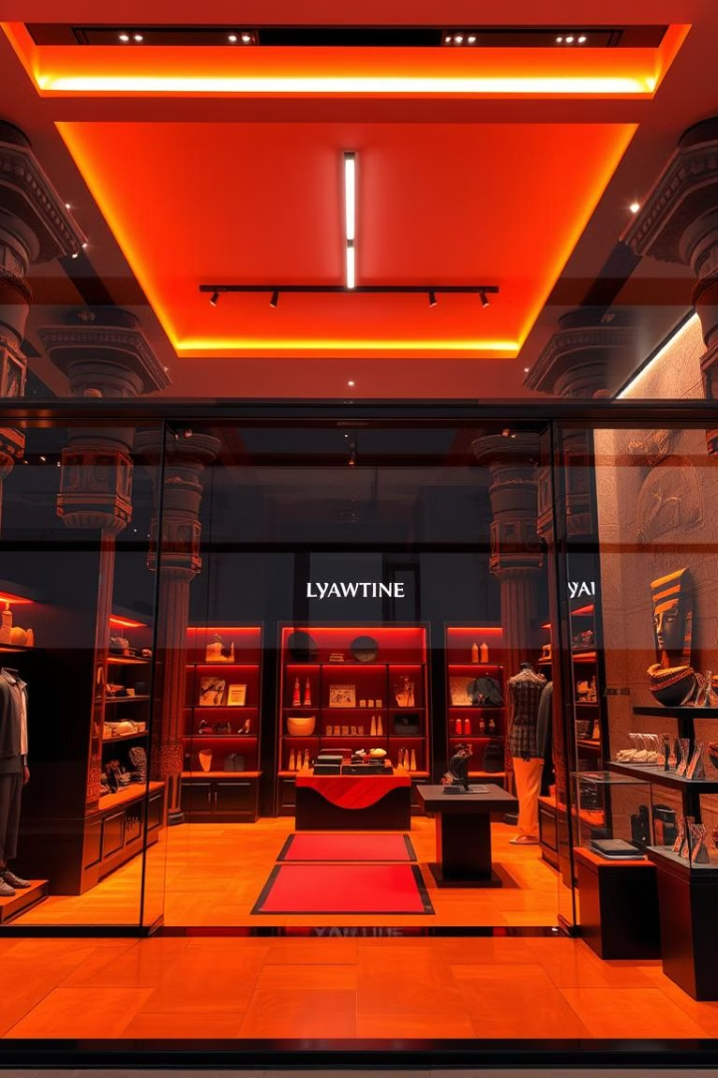
Positioning Antika Onlinstore
Authenticity Meets Affordability
Exclusivity & Craftsmanship
Offer genuine antiques and budget-friendly replicas.
Highlight luxury handcrafted items.
Sustainability
Promote repurposed and eco-friendly products.

Slide 4

Marketing Mix: 7Ps
Product
Price
Authentic antiques and modernized replicas.
Premium and tiered pricing strategies.
Place
Promotion
E-commerce and social media shops.
Storytelling, paid ads, and content marketing.

Slide 5
SWOT Analysis
Strengths
Weaknesses
Opportunities
Threats
Unique designs, growing social media presence, moderate production costs.
Limited brand awareness, high shipping costs, narrow product range.
Increasing demand, international market expansion, museum partnerships.
Strong competition, economic fluctuations, social media dependency.

Slide 6
SOSTAC Marketing Plan
Situation Analysis
1
Growing demand for Pharaonic-themed decor and gifts.
2
Objectives
Increase brand awareness by 40% in 6 months. Achieve 1,000 online sales in the first year. Expand product range and strengthen brand identity.
Strategy
3
Position Antika as the go-to store for Pharaonic-themed products. Focus on storytelling and cultural heritage in marketing.
4
Tactics
Social media marketing, paid ads, influencer partnerships. Website optimization and email marketing.
Action Plan
5
Content calendar, ad campaigns, influencer collaborations. Ensure product availability and streamline fulfillment.

Slide 7
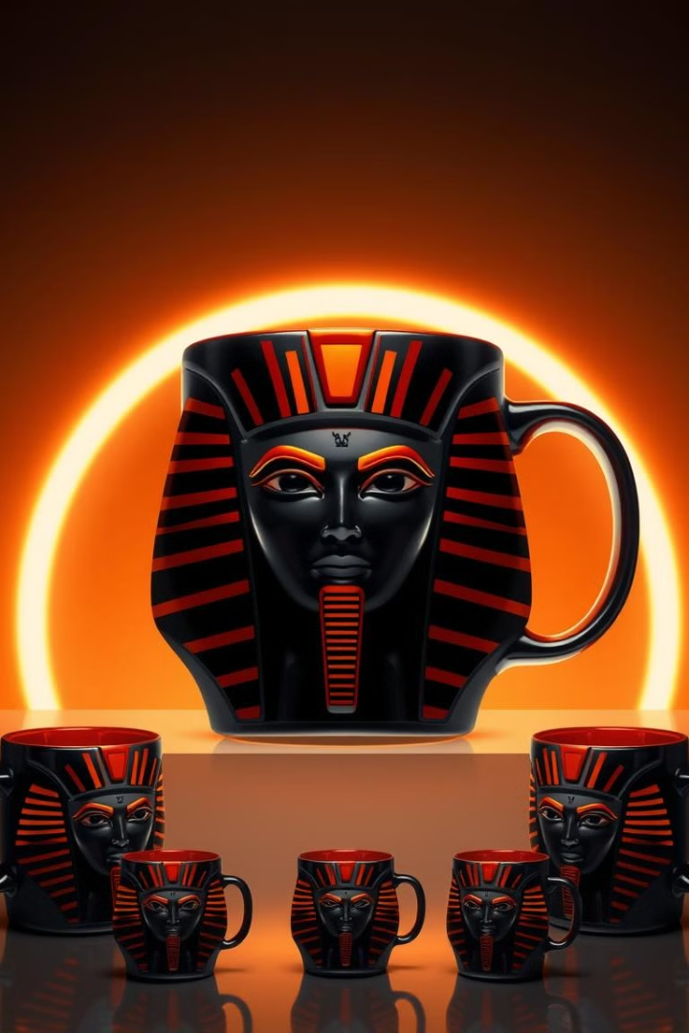



Branding Strategies
Visual Identity
Digital Marketing
Product Expansion
Modern take on Egyptian elements (hieroglyphs, Pharaoh motifs). Colors: gold, turquoise, beige, and black.
Content: product images, short videos, educational posts. Campaigns: focus on Pharaonic themes across various products.
Introduce Pharaonic-themed clothing and accessories.

Slide 8






PESTEL Analysis
Political
Follow e-commerce laws, customs rules, and consumer protection policies. Political stability in markets affects shipping and pricing.
Economic
Economic changes impact what customers can afford and shipping costs. Offer both affordable and premium products to attract more buyers.
Social
People love Pharaonic culture, which creates demand for your products. Use storytelling and target different age groups with tailored marketing.
Technological
Use social media, secure payments, and tools like 3D previews to improve customer experience. Invest in new technology to stand out from competitors.
Environmental
Use eco-friendly packaging and partner with green shipping companies. Promote sustainability to attract environmentally aware customers.
Legal
Follow online sales laws, protect your designs, and meet certification requirements. Clear policies and legal compliance build trust with customers.

Slide 9
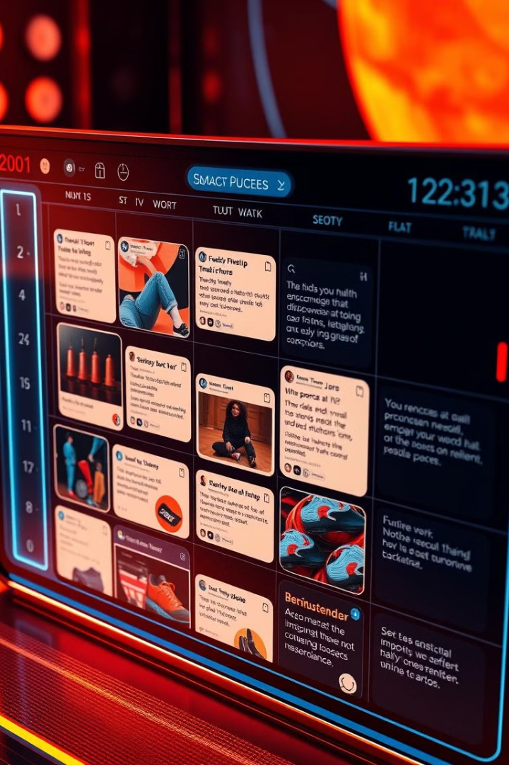
Daily Posting Strategy
Main Goals
Promote Pharaonic-themed products. Build a loyal customer base. Drive sales and expand reach.
Main Content Themes
Showcase products with high-quality images and videos. Share facts about Pharaonic history and culture. Highlight customer testimonials and reviews. Offer styling tips and product usage ideas. Run promotions, discounts, and giveaways.
Posting Frequency and Platforms
Daily posts on Facebook, Twitter, Instagram, Snapchat, and TikTok. Tailor content for each platform.

Slide 10

Conclusion & Next Steps
Build Brand Identity & Awareness
Through storytelling and engaging content.
Execute SOSTAC Plan & Monitor Metrics
Track key performance indicators to measure success.
Expand Product Offerings & Explore New Markets
Continuously innovate and reach new audiences.
Foster Customer Engagement & Refine Strategies
Listen to customer feedback and adapt marketing strategies accordingly.

